Slide 1
Linux Round 1 Review
Jonathan Liu

Slide 2
Distribution of Vulnerabilities
Forensics Questions - 2 (16 points)
User Configuration - 6 (20 points)
Groups - 2 (10 points)
Firewall - 1 (5 points)
Updates - 4 (18 points)
Removing Prohibited Files - 4 (16 points)
Firefox Settings - 1 (5 points)
Critical Service Configuration - 1 (5 points)
Services - 1 (5 points)

Slide 3
Forensics Questions
user/group ids
id <username>
getent group <groupname>
Checksums for file:
md5sum <filename>
sha256sum <filename>
File Permissions:
ls -l <filename>
getfacl <filename>

Slide 4
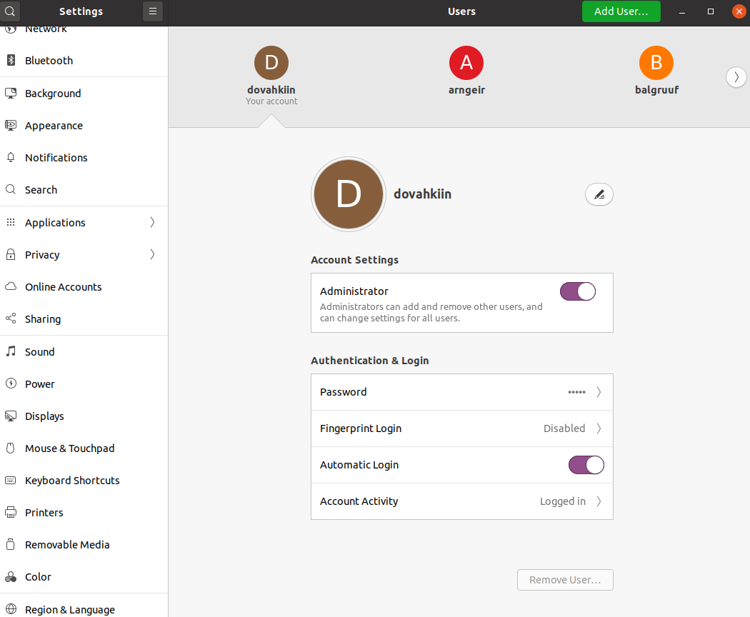
User Configuration
Add specified users (1)
Delete unauthorized users (2)
Change insecure passwords (1)
Remove/Give Administrator Privileges (2)

Slide 5
Groups
Add users to groups specified in ReadMe (1)
sudo adduser <user> <groupname>
Add any specified groups (1)
sudo addgroup <groupname>

Slide 6
Firewall
Enable Firewall (1)

Slide 7
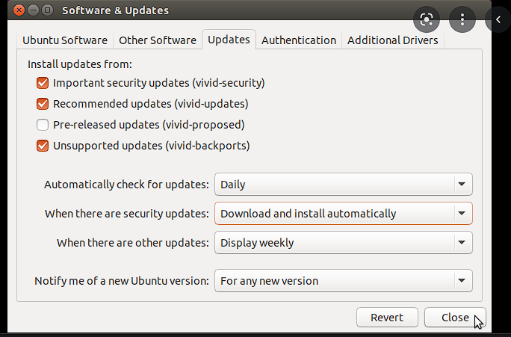
Updates
Update system (3)
Turn on automatic updates (1)
Under software and updates
Install security updates

Slide 8
Removing Prohibited Files
Remove hacking tools/games (3)
sudo apt-get purge <package>
ex. sudo apt-get purge firefox
Remove media files (ex. MP3, MP4, MOV) (1)

Slide 9
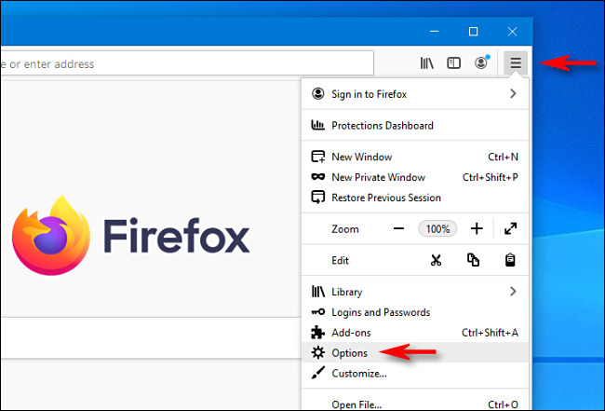
Firefox Settings
Use Strictest settings (1)
Block pop-ups
Block dangerous downloads

Slide 10
Critical Service Configuration
Configure SSH (1)
Example configs found in /etc/ssh/sshd_config
Disable root login
Don’t allow empty passwords
Use Protocol 2
“The major differences between SSH1 and SSH2 fall into two main categories: technical and licensing. Technically, SSH2 uses different encryption and authentication algorithms. SSH1 supported four encryption algorithms, two of which had been found to be insecure.” (Source)

Slide 11
Services
DON’T DISABLE CRITICAL SERVICES (1)
Disable remote connection services
Disable file transfer services
Disable mailing services
sudo systemctl stop <service name>

